Slide 1
Fundamentals of Computer Programming CS-110
Lecture - 2

Slide 2
Problem Solving and Implementation
A programming task can be divided into two phases:
1. Problem solving
Define : Clearly describe a problem
Design its solution: Produce an ordered sequence of steps that describe solution to the problem;
2. Implementation phase
Implement the program in some programming language write code, compile, link, Test & Debug

Slide 3
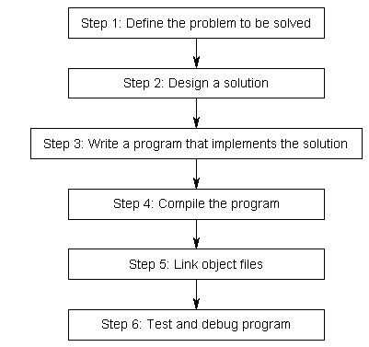
Developing a program
Problem solving
Phase
Implementation phase

Slide 4
Defining a Problem:
Break the definition of the problem down into manageable steps. Example; input, Processing; Output
Input: Read the temperature from keyboard
Processing: Test the Temperature below or above freezing
Output: Display the result on Screen
Users: Identify the users.

Slide 5
Design the solution
Algorithm
A sequence of language independent steps which may be followed to solve a problem. An Algorithm can be developed with a:
Pseudo Code
Flowchart
Preferably using control Structures.

Slide 6
Algorithm
Pseudo code
Pseudo code is a method of designing a program using English like statement to describe the logic and processing flow.
There are no real rules; organizations follow their own standards. Conveniently understood and exchanged between IT professionals.

Slide 7
Defining a Problem:
Break the definition of the problem down into manageable steps; Input, Processing; Output
Example -1:
Read in the temperature. If the temperature is less than 32 indicate below freezing on the screen. Else if the temperature is above freezing then indicate the same on the monitor screen.
Divide the above problem into manageable parts.
Input ; Read the temperature from keyboard
Processing; Test the Temperature below or above freezing
Output; Display the result on Screen

Slide 8
Algorithm
Pseudo code
Example -1:
Read the Temp
if (Temp < 32) then
Print “BELOW FREEZING”
else
Print “ABOVE FREEZING”
endif

Slide 9
Algorithm
Flowchart
Diagrammatic or Graphical representations of steps for solving the given problem.
Use standard symbols developed by ANSI (American National Standard Institute)

Slide 10
Building Blocks of Flowchart
  Start and End Symbols
  Connector
  Arrows (indicate flow of control)
  Processing Steps
  Input/output
  Decision

Slide 11
Defining a Problem:
Break the definition of the problem down into manageable steps; Input, Processing; Output
Example -1:
Read in the temperature. If the temperature is less than 32 indicate below freezing on the screen. Else if the temperature is above freezing then indicate the same on the monitor screen.
Divide the above problem into manageable parts.
Input ; Read the temperature from keyboard
Processing; Test the Temperature below or above freezing
Output; Display the result on Screen

Slide 12
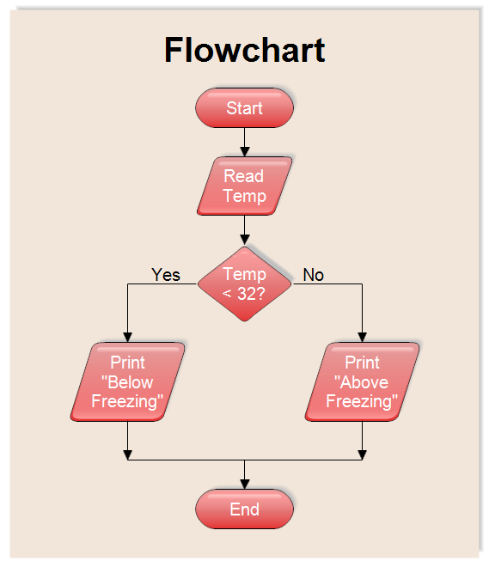

Slide 13
Define The Problem
Example-2;
Determine the sum of first 50 natural numbers.
Break into steps
Input – Nil
Processing: Sum the numbers from 1 to 50
Output - Sum

Slide 14
Design the Solution
Example-2;
Determine the sum of first 50 natural numbers.
Algorithm; Pseudo Code
1. Set N=1
Set Sum = 0
2. Repeat step 3 & 4 while N <= 50
3. Sum = Sum + N
4. N = N + 1
5. Print Sum
6. end

Slide 15
Design the Solution
Example-2; Determine the sum of first 50 natural numbers.
Algorithm; Flow Chart
Start
Sum=0
N=1
N≤50
N
Sum=Sum+N
N=N+1
Y
Print Sum
End

Slide 16
Example-3:
Determine the factorial of input number

Slide 17
Define The Problem
Example-3; Determine the factorial of input number.
Break into steps
Input – Number is N
Processing: Factorial = N x N-1 x N-2 x N-3 ……. 3 x 2 x 1
Output - Factorial

Slide 18
Design the Solution
Example-3; Determine the factorial of an input number.
(assume number is positive)
Algorithm; Pseudo Code
1. Set Factorial = 1
2. Read N from keyboard
3. if ( N = 0 ) goto step 6
4. Factorial = Factorial x N
5. N = N – 1 ; goto step 3
6. Print Factorial
5. end

Slide 19
Design the Solution
Determine the factorial of an input number.
Algorithm; Flowchart
Start
Read N
Fact =1
Y
N = 0
N
Print Fact
Fact =Fact *N
End
N=N-1

Slide 20
Control Structure:
Definition;
A control structure or logic structure is a structure that controls the logical sequence in which the instructions are executed. Three types of control structure are used:
Sequence
Selection
Iteration ( or loop)

Slide 21
Developing a program
Problem solving
Phase
Implementation phase

Slide 22
Implementation Phase
Write a program (source code)
Compile a program (source code to Object code)
Link a Program ( Object code to Executable code)
Test and Debug the Program (rectify the errors in the program)

Slide 23
Write a code
Create a source code we need an editor
Line editor --- line by line editing
Screen editor --- note pad, word pad, customized editor
After writing the code we save the code with file extension
e.g .c .cpp

Slide 24
Compile a program
source code to Object code
We need a compiler e.g FORTRAN, PASCAL, C or C++
It converts user readable code to machine readable code
Cannot be executed because different sections are not mapped together, say not linked together

Slide 25
Link a Program
Object code to executable code
first.obj to first.exe
Can be executed because different sections are mapped together.
Execute the code by simply typing the name of file
first.exe or even first

Slide 26
Test and Debug the program
Rectifying logical errors in the code, manually or may Use debugger for the assistance. A debugger may:
Execute the code line by line or block by block or in one go
Examine the contents of variables and registers at each step
Examining the flow of control structure by tracing code step by step.

Slide 27
Two ways:
1. Use command prompt e.g DOS or UNIX command prompt
2. Use Integrated Development Environment
Program Execution

Slide 28
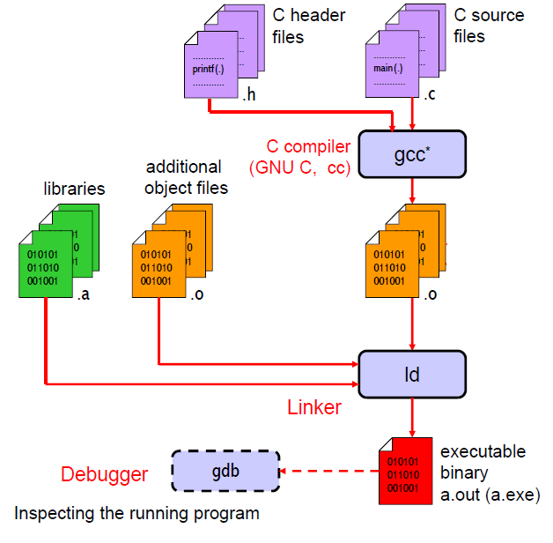
Command prompt

Slide 29
1. A source code editor
2. A compiler and / or an interpreter
3. Build automation tools
4. A Debugger
Integrated Development Environment (IDE)
Compiler – translates complete code in one go
Interpreter –translates code one line at a time

Slide 30
Typical C environment
Editor
Program is created in
the editor and stored
on disk.
Disk
Preprocessor
Disk
Preprocessor program
processes the code.
Compiler creates
object code and stores
it on disk.
Compiler
Disk
Linker
Disk
Linker link the libraries with object code performs address calculations map the variables and produces the .exe file
Primary
Memory
Loader
Loader puts program
in memory.
Disk
.
.
.
.
.
.
Primary
Memory
CPU
CPU takes each
instruction and
executes it, and
store new data
values as the program
executes.
.
.
.
.
.
.

Slide 31
The Parts of a C++ Program

Slide 32
The Parts of a C++ Program
// sample C++ program
#include <iostream>
using namespace std;
int main()
{
cout << "Hello, there!";
return 0;
}
comment
preprocessor directive
which namespace to use
beginning of function named main
beginning of block for main
output statement
string literal
send 0 to operating system
end of block for main

Slide 33
Special Characters
Character | Name | Meaning
// | Double slash | Beginning of a comment
# | Pound sign | Beginning of preprocessor directive
< > | Open/close brackets | Enclose filename in #include
( ) | Open/close parentheses | Used when naming a function
{ } | Open/close brace | Encloses a group of statements
" " | Open/close quotation marks | Encloses string of characters
; | Semicolon | End of a programming statement

Slide 34
The #include Directive

Slide 35
The #include Directive
Inserts the contents of another file into the program
This is a preprocessor directive, not part of C++ language
#include lines not seen by compiler
Do not place a semicolon at end of #include line

Slide 36
The cout Object

Slide 37
The cout Object
Displays output on the computer screen
You use the stream insertion operator << to send output to cout:
  cout << "Programming is fun!";

Slide 38
The cout Object
Can be used to send more than one item to cout:
  cout << "Hello " << "there!";
  Or:
  cout << "Hello ";
  cout << "there!";

Slide 39
The cout Object
This produces one line of output:
cout << "Programming is ";
cout << "fun!";

Slide 40
The endl Manipulator
You can use the endl manipulator to start a new line of output. This will produce two lines of output:
cout << "Programming is" << endl;
cout << "fun!";

Slide 41
The endl Manipulator
cout << "Programming is" << endl;
cout << "fun!";
Programming is
fun!

Slide 42
The endl Manipulator
You do NOT put quotation marks around endl
The last character in endl is a lowercase L, not the number 1.
endl
This is a lowercase L

Slide 43
The \n Escape Sequence
You can also use the \n escape sequence to start a new line of output. This will produce two lines of output:
cout << "Programming is\n";
cout << "fun!";
Notice that the \n is INSIDE
the string.

Slide 44
The \n Escape Sequence
cout << "Programming is\n";
cout << "fun!";
Programming is
fun!

Slide 45
The cin Object

Slide 46
The cin Object
Standard input object
Like cout, requires iostream file
Used to read input from keyboard
Information retrieved from cin with >>
Input is stored in one or more variables

Slide 47
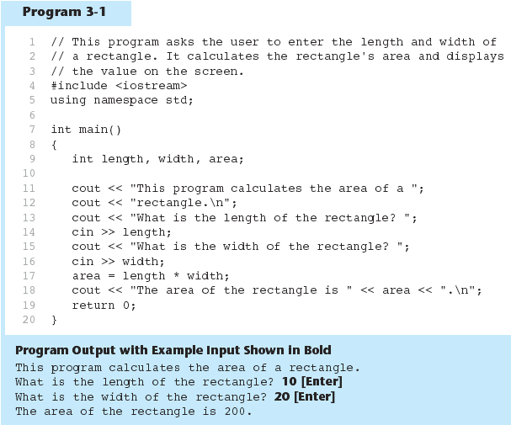
The cin Object in Program

Slide 48
The cin Object
cin converts data to the type that matches the variable:
  int height;
  cout << "How tall is the room? ";
  cin >> height;

Slide 49
Displaying a Prompt
A prompt is a message that instructs the user to enter data.
You should always use cout to display a prompt before each cin statement.
cout << "How tall is the room? ";
cin >> height;

Slide 50
The cin Object
Can be used to input more than one value:
  cin >> height >> width;
Multiple values from keyboard must be separated by spaces
Order is important: first value entered goes to first variable, etc.

Slide 51
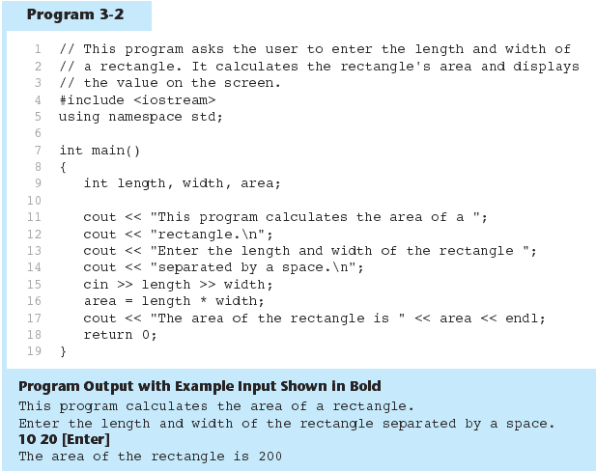
The cin Object Gathers Multiple Values in Program

Slide 52
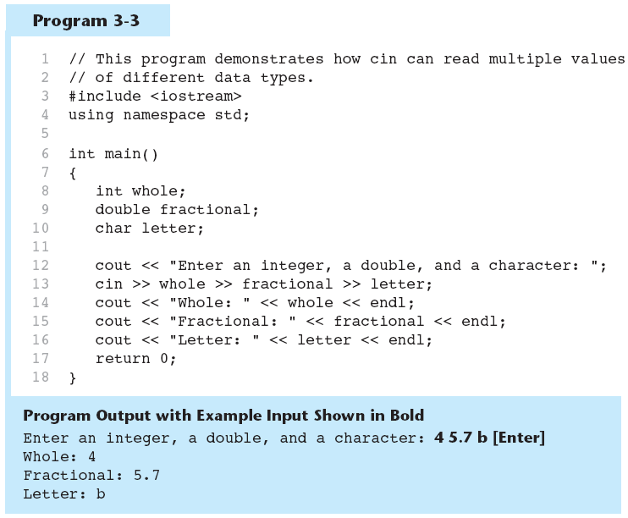
The cin Object Reads Different Data Types in Program

Slide 53
QUIZ

Slide 54
Quiz
What is the difference between data and Information?
What is the difference between volatile and non-volatile memory?
Memory is used for?
Name a device which is both input and output?
Give few examples of utility software.
What is the use of embedded systems?
What does computer do in i-time and e-time?

